Slide 1


UNIVERSITY VISVESWARAYA COLLEGE OF ENGENEERING ,KR CIRCLE BANGALORE COMPUTER SCIENCE AND ENGG. COMPUTER GRAPHICS MINI PROJECT ON “FIGHTER JET” Submitted By : KAVYA S R(18GAEC9028)

Slide 2
ABSTRACT
In this mini-project (FIGHTER JET), the operations performed by the jet are simulated graphically using OpenGL. Specific functions of OpenGL are used to simulate various operations of the jet.
The perspective concept will be implemented to provide a real-world effect. The fighter jet can be moved towards the required direction. It can be rotated in any direction as well. Various functions performed by jet are bullet firing, enabling a protective shield, can increase the throttle as required. The jet can destroy the objects present on the screen through bullet firing.

Slide 3
OVERVIEW OF PROJECT
By using the keyboard interface, we perform the required action. The various key functions are:
“up” arrow key to increase throttle
“right” arrow key for the clockwise motion of the fighter jet.
“left” arrow key for the anti-clockwise motion of the fighter jet.
“Q” or “space bar” key used to fire the bullets
“S” key used to enable protective shield
“P” key is to pause the action of the fighter jet.

Slide 4
REQUIREMENTS SPECIFICATION
REQUIREMANT SPECIFICATION:- The hardware and software requirement for the efficient working of our project are specified as follows:
HARDWARE REQUIREMENTS :-
Hard disk -500GB and above
RAM -4GB and above
Processor - Intel or Pentium
SOFTWARE REQUIREMENTS :-
Windows XP operating system
CODE::BLOCKS complier
OpenGL libraries - gl, glut, OpenGL

Slide 5
IMPLEMENTATION
User Defined Functions:-
There are eight user defined functions in the source code of a project in OpenGL.
Void drawsquare();
This function used to draws the squares
Void drawjet();
This function used to draw the jet.
Void drawshield();
This function is used to draw the protective sheild.
Void drawbullets();
This function is used to draw bullets.
Void shotbullets();
This function is used to shot bullets towards object.
Void display(void);
This function is used to display the things and objects in screen.

Slide 6
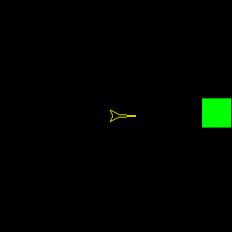

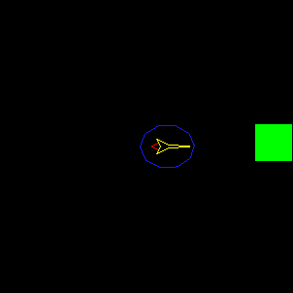
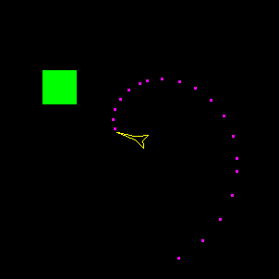
SNAPSHOTS OF PROJECT

Slide 7
THANK YOU

